Slide 2
FAPXILTM
Oral Therapeutic for Familial Adenomatous Polyposis (FAP)
FAP…
is a rare inherited condition that affects the gastrointestinal tract
leads to the development of hundreds to thousands of polyps inside the colon or rectum
may require a total colectomy in the second decade of life due to a high number of polyps and the high risk (100%) of colorectal cancer
has no effective treatments
has an incidence at birth of about 1/8,300, manifests equally in both sexes, and affects up to 50,000 Americans, making it eligible for orphan status
For more information about the disease, click here
Additionally, FAPXIL has the potential to be applicable to ulcerative colitis and Crohn’s Disease

Slide 3
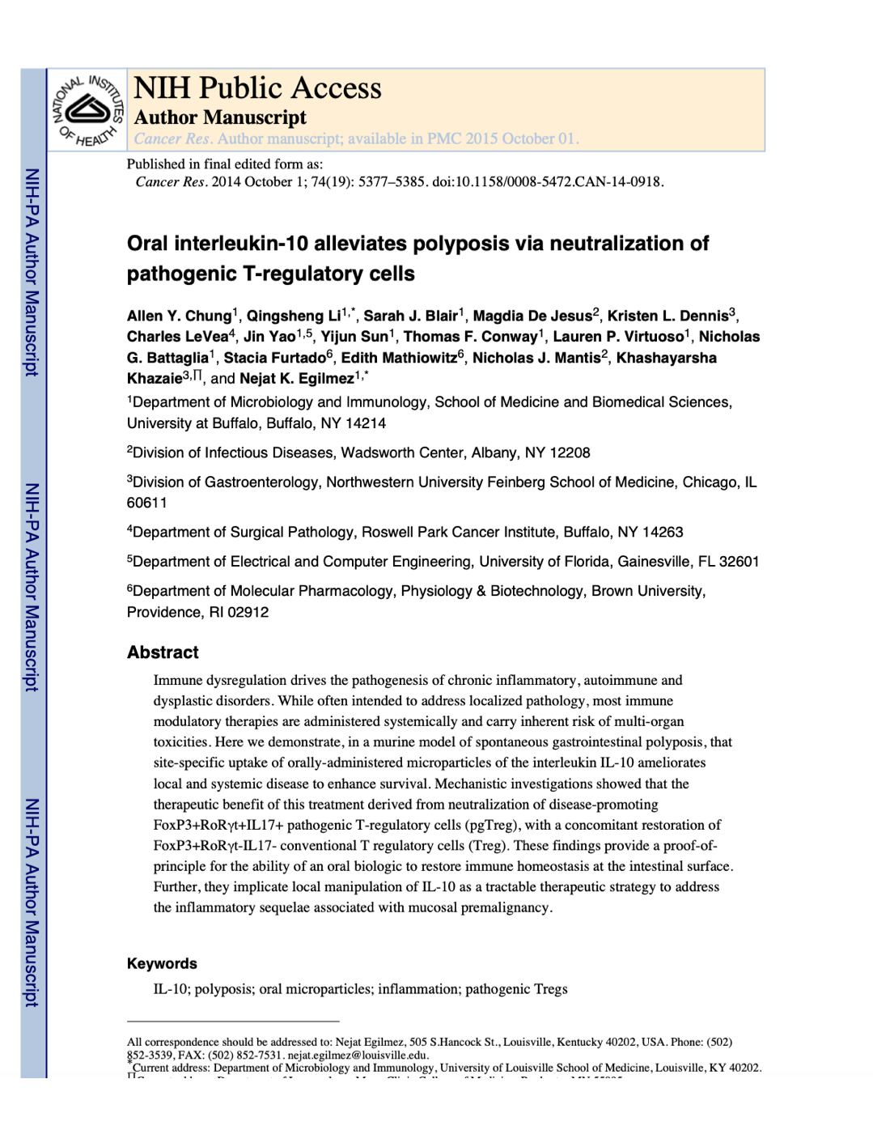
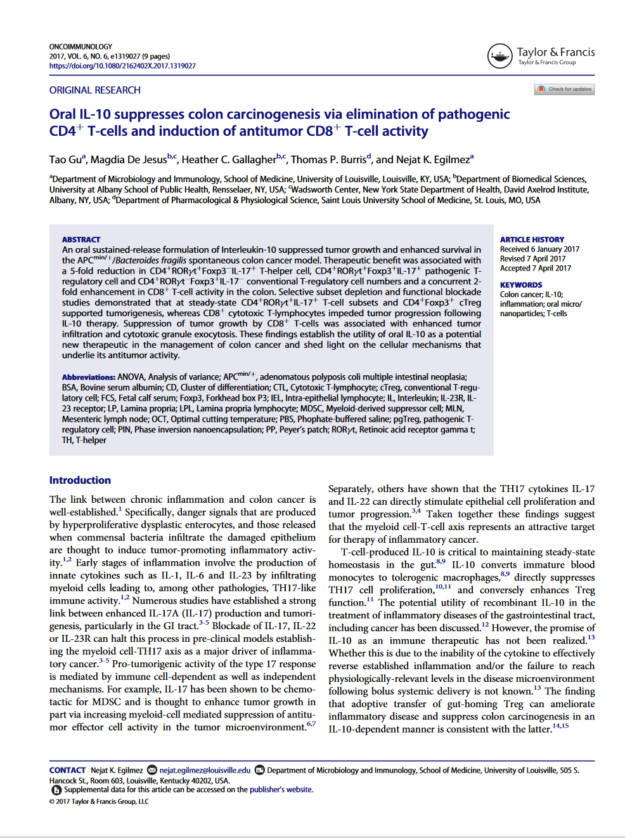
FAPXILTM
Oral Therapeutic for Familial Adenomatous Polyposis (FAP)

Slide 4
FAPXIL (IL-10) Development status
Oral Therapeutic for Familial Adenomatous polyposis
Efficacy and CMC
With a $2 million Fast Track SBIR award:
Efficacy was established in mice
Treatment was optimized in mice
Initial bioavailability and pharmacokinetics following a single administration was performed in mice
Regulatory Status
Type C meeting completed: Agency concurred on single species toxicity study in monkeys
ODD Application for orphan status protections in progress
Indication expansion: Publication in mouse models of colitis
Next Steps
Type B meeting with FDA
Manufacture of clinical grade material with GMP drug substance for use in monkey toxicology

